Slide 1
Today’s Outline
Agents and Environments
Good Behavior: Rationality, Omniscience & Autonomy
PEAS (Performance measure, Environment, Actuators, Sensors)
Environment types
Agent types
1

Slide 2
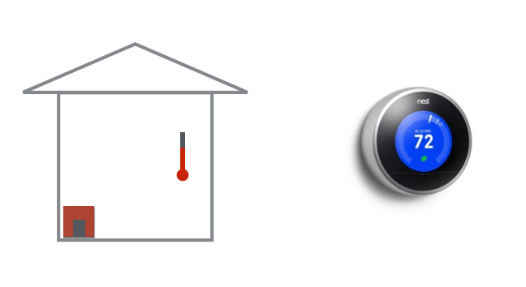

Slide 3
AI Entities
When creating artificial intelligence, the purpose is to produce entities that can operate independently of human direction.
– An entity may act on a human’s behalf though
These entities need to have the following properties:
– Autonomy = needs no direct involvement to perform duties.
– Responsive (reactivity) = must be able to perceive and react to its environment.
– proactivity = must exhibit goal-directed behavior.
– Sociability = interacts with humans and other agents.
Notes:
Proactive Calendar Management: The AI schedules meetings by considering your past availability, workload, and typical patterns. It might suggest blocking out focus time if it notices your schedule is becoming too crowded, or it could reschedule events based on priority without being told to do so.
Recommendation Systems: An e-commerce AI that doesn't just react to your searches but proactively suggests products based on your buying habits, future events (like upcoming holidays), or even what you may need next.

Slide 4
Agent Definition (2)
Agents = a software entity that exists in an environment and acts on that environment based on its perceptions and goals.
4

Slide 5
Agent Definition (3)
The starting point for the agent-based view is ourselves.
• As humans, we have to be able to perceive the world (computer vision), perform actions in it (robotics), and communicate with other agents.
• We also have knowledge about the world (from how to ride a bike to knowing the capital of France) and using this knowledge we can draw inferences and make decisions.
• Finally, we learn and adapt over time.
5

Slide 6
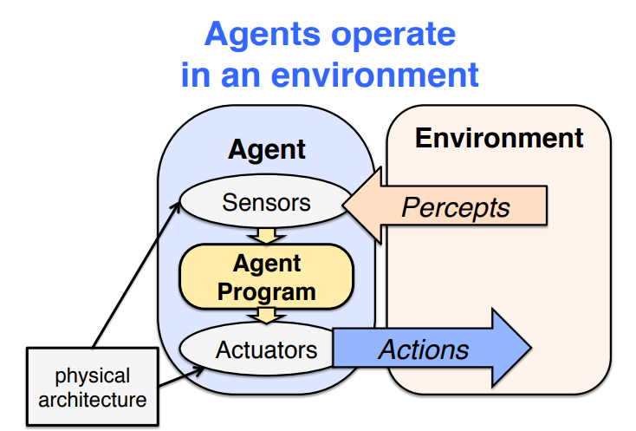

Slide 7
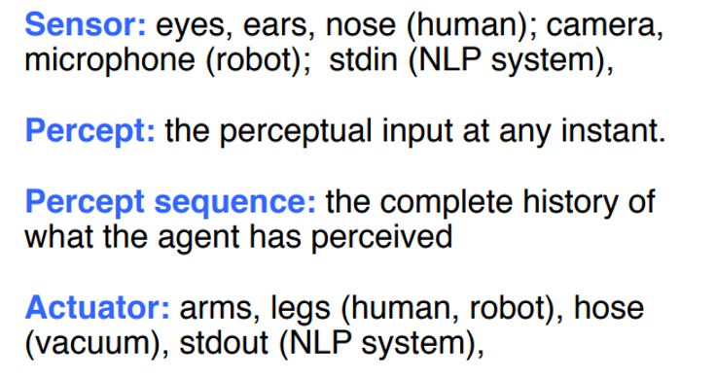
Agent Example
An agent perceives its environment via sensors and acts upon that environment through its Actuators

Slide 8
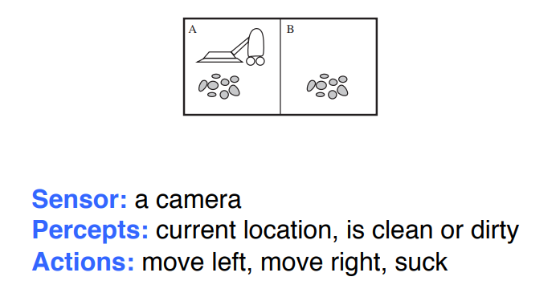
Example: The vacuum world

Slide 9
Example:
Agent: A self-driving car.
Environment: A road with traffic, pedestrians, and weather conditions.
Perception: The car's cameras, radar, and lidar sensors gather information about its surroundings.
Action: The car's steering, acceleration, and braking systems allow it to navigate the environment.

Slide 10
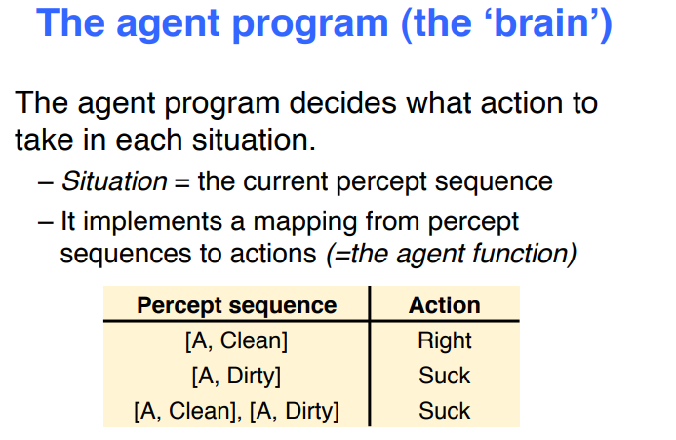

Slide 11
Perception
Perception is the result of the function
see: S → P
where
– P is a (non-empty) set of percepts (perceptual inputs).
Then, the action becomes:
action: P → A
which maps sequences of percepts to actions
S → P: Camera detects red traffic light → interpreted as “red = stop.”
P → A: Percept “red = stop” → triggers action apply brakes.

Slide 12


Perception ability
Non-existent perceptual ability
Omniscient
MIN
MAX
| E | = 1
| E | = | S |
Where E: is the set of different perceived states.
Vision:
Color: Seeing the color "red" as opposed to "blue" is a distinct state.
Shape: Distinguishing a circle from a square represents two different states.
Hearing:
Pitch: Distinguishing a high-pitched sound from a low-pitched sound represents different states.
Volume: Perceiving a sound as loud or soft are separate states.

Slide 13
Perception ability
Non-existent perceptual ability
Omniscient
MIN
MAX
| E | = 1
| E | = | S |
Two different states s₁∈ S and s₂ ∈ S (with s₁ ≠ s₂) are
indistinguishable if see( s₁ ) = see( s₂ ).
s₁ and s₂ are indistinguishable if they are perceived the same way.
This means that someone with limited perception ability might not be able to tell the difference between certain states, even if they are objectively different.

Slide 14
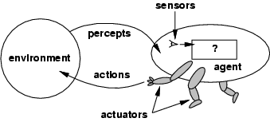
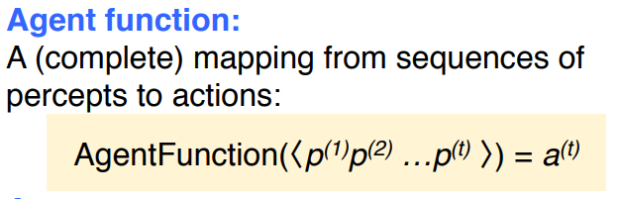
Agents and environments
The agent program is an implementation of f that runs on the physical architecture to produce f
agent = architecture + program
10

Slide 15
Example
The agent function might map: (Ideal World)
Percept 1: "There’s dust in the corner"
Percept 2: "The chair is in the way"
Percept 3: "The battery is low“
into a perfect action like:
Action: "Move around the chair, clean the dust in the corner, and return to the charging dock before the battery dies."
Agent Program (Real-world):
Sensors are imperfect; environment changes.
Approximates agent function using available data.
Practical challenges:
Detects dust but not as precisely.
Bumps into furniture occasionally.
Might return to the dock without finishing the cleaning if the battery is low.

Slide 16
Rational agents
Rationality: At any given time it depends on four things i.e.
Performance measure that defines success
Agents prior knowledge of environment
Actions that agent can perform
Agent’s percept sequence to date
Rational Agent: For each possible percept sequence, a rational agent should select an action that is expected to maximize its performance measure, given the evidence provided by the percept sequence and whatever built-in knowledge the agent has.

Slide 17
Rational agents
Imagine a self-driving car as a rational agent.
Performance measure: Safely reach the destination while minimizing travel time.
Prior knowledge: Traffic laws, road map, car's capabilities.
Possible actions: Accelerate, brake, change lanes, etc.
Percept sequence: Objects detected by sensors (other cars, pedestrians, traffic lights).
The car continuously perceives its surroundings, considers actions like changing lanes to overtake a slow car, and selects the action that aligns best with its goals, considering safety and efficiency.

Slide 18
Rationality vs Omniscience
Rational is different from omniscience
A rational agent chooses the best possible action given what it knows
An omniscient agent would know everything about the world
E.g., in card game, don’t know cards of others.
Rationality is about making reasonable decisions with limited information
Rational is different from being perfect
Rationality maximizes expected outcome
while perfection maximizes actual outcome.

Slide 19
Specifying the Task Environments
Task Environments are essentially the problems to which rational agents are the solutions.
It defines everything the agent needs to know and interact with in order to act rationally.
In designing an agent the first step must always be to specify the task environment as fully as possible a.k.a PEAS (Performance measure, Environment, Actuators, Sensors)
Example (Automated Taxi): Consider, e.g., the task of designing an automated taxi driver agent:
Performance measure: Safe, fast, legal, comfortable trip, maximize profits.
Environment: Roads, other traffic, pedestrians, customers.
Actuators: Steering wheel, accelerator, brake, signal, horn.
Sensors: Cameras, sonar, speedometer, GPS, odometer, engine sensors, keyboard.

Slide 20
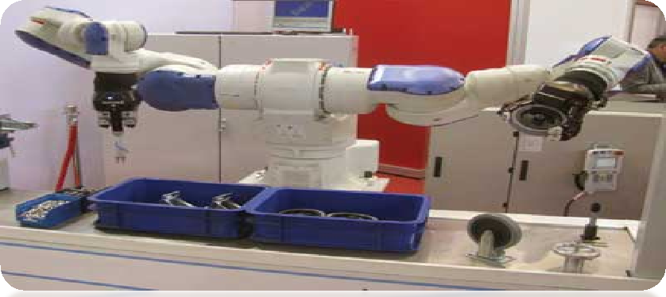
PEAS - Example # 02
Agent: Part-Picking Robot
Performance measure: Percentage of parts in correct bins
Environment: Conveyor belt with parts, bins
Actuators: Jointed arm and hand
Sensors: Camera, joint angle sensors

Slide 21
Autonomy in Agents
The autonomy of an agent is the extent to which its behaviour is determined by its own experience, rather than knowledge of designer.
Extremes
No autonomy – ignores environment/data
Complete autonomy – must act randomly/no program
Example: baby learning to crawl
Ideal: design agents to have some autonomy
Possibly become more autonomous with experience

Slide 22
Autonomy in Agents
Not completely determined by designer: The car doesn't blindly follow a pre-programmed route, but can adjust its speed, lane, and braking based on traffic conditions, obstacles, and other factors.
Not completely random: The car has clear goals (reach the destination safely) and operates within traffic laws and safety regulations.
Learns from experience: Over time, the car's algorithms can improve by learning from driving data and past scenarios.

Slide 23
Environment types
Fully observable vs. partially observable
Deterministic vs. stochastic
Episodic vs. sequential
Static vs. dynamic
Discrete vs. continuous
Single agent vs. multi-agent

Slide 24
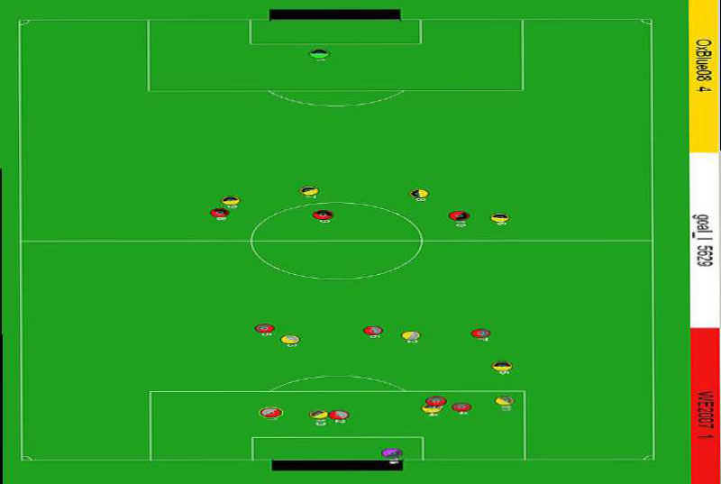
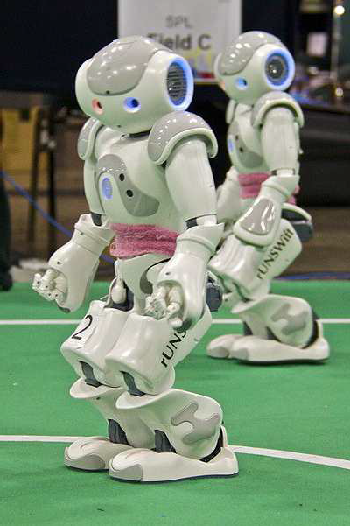
Fully observable vs. partially observable
Do the agent's sensors give it access to the complete state of the environment?
– For any given world state, are the values of all the variables known to the agent?
vs.

Slide 25
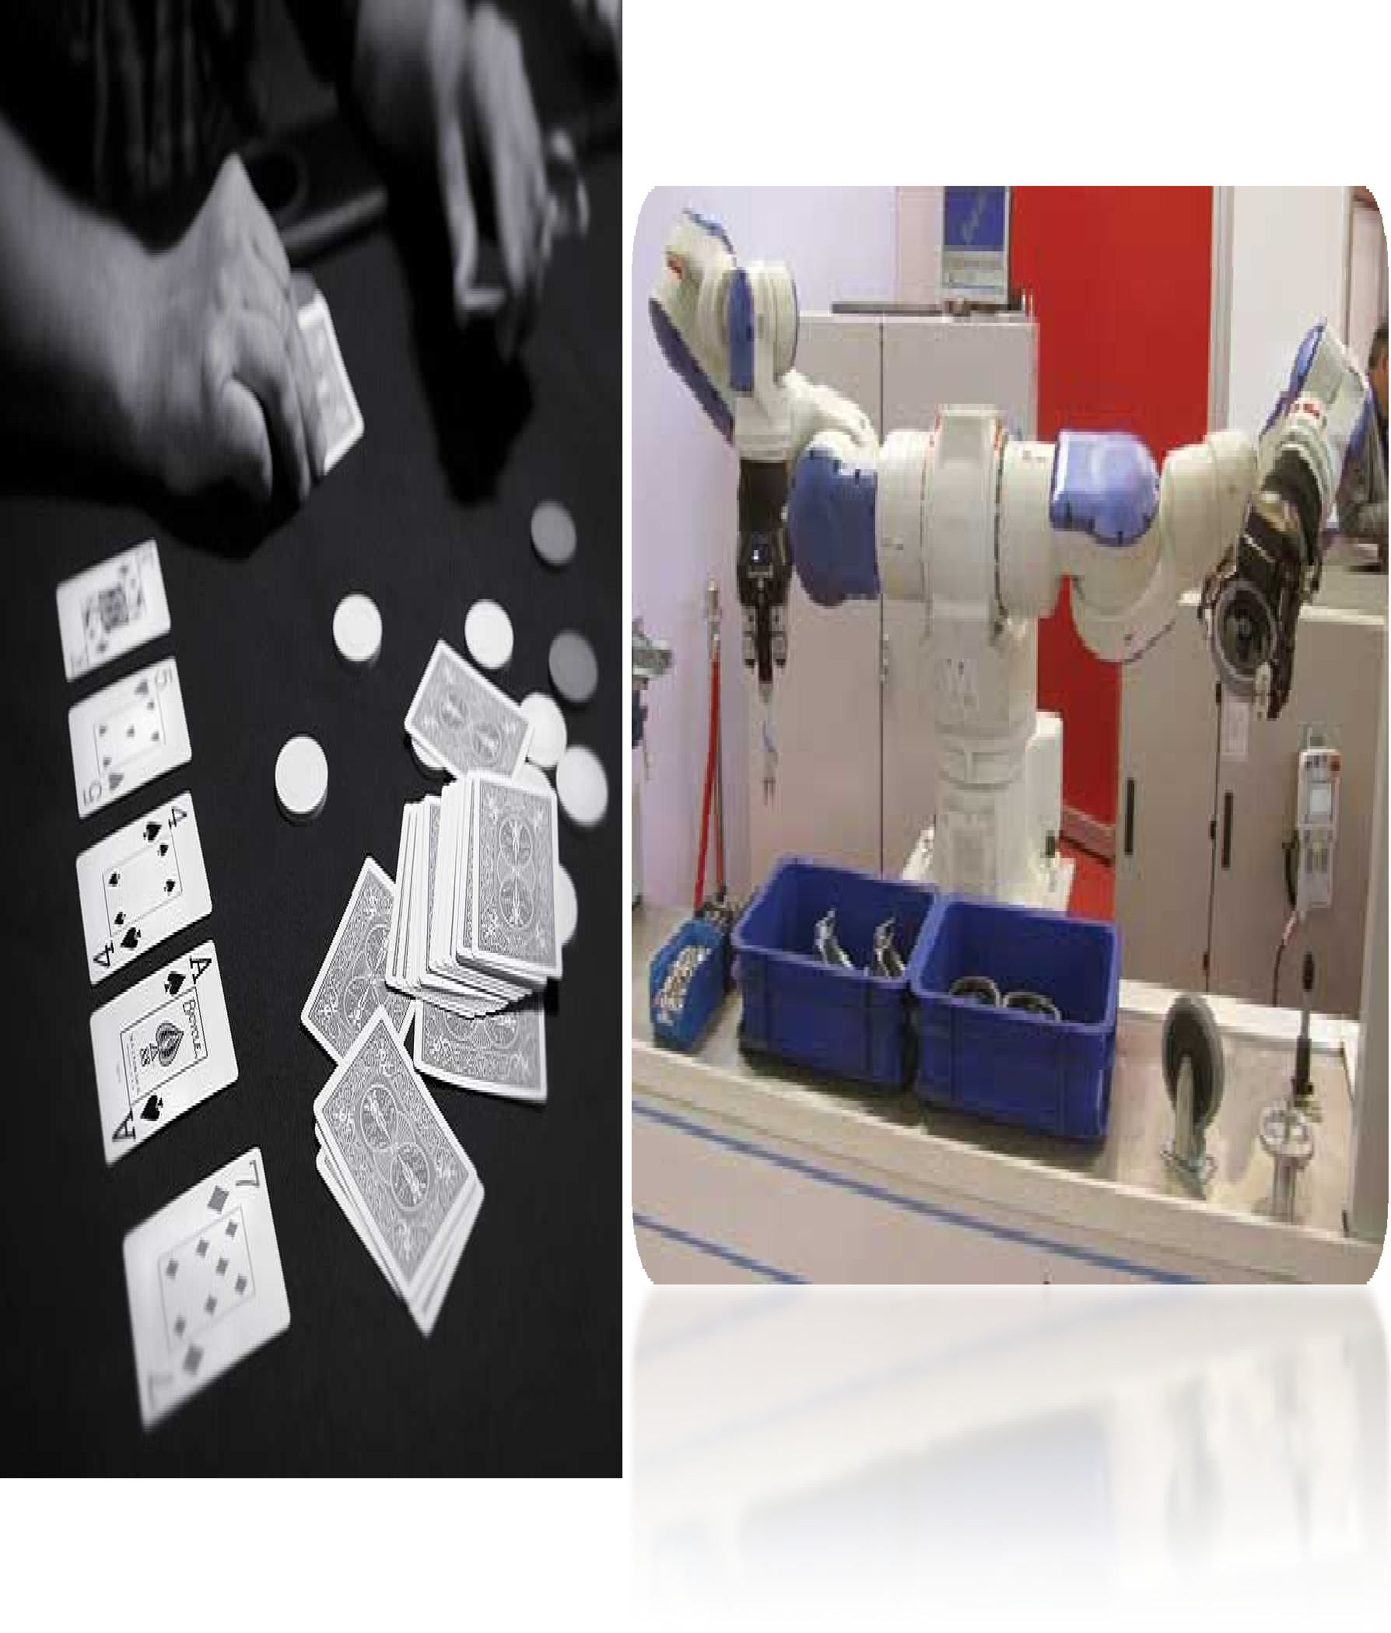
Examples
Poker Game (Partially)
Part Picking Robot (Fully)
19

Slide 26
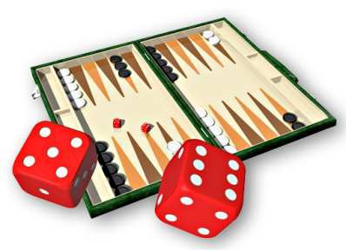
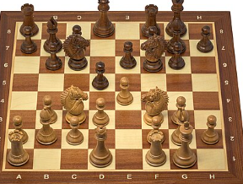
Deterministic vs. stochastic
Is the next state of the environment completely determined by the current state and the agent’s action?
Is the transition model deterministic (unique successor state given current state and action) or stochastic (distribution over successor states given current state and action)?
Strategic: the environment is deterministic except for the actions of other agents
vs.

Slide 27
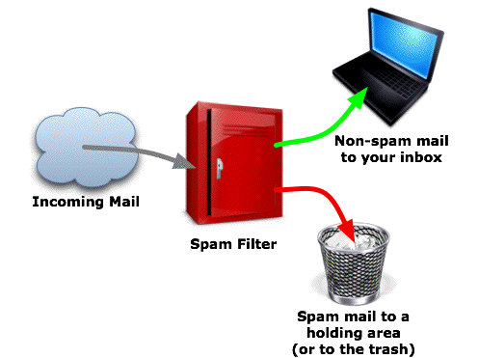
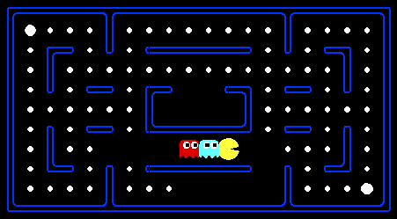
Episodic vs. sequential
Episodic: Agent receives a single percept per episode. Its action in this episode does not affect future percepts (e.g. classification)
Sequential: Agent receives a sequence of percepts. The current action affects future percepts. (e.g. navigation, game playing)
vs.

Slide 28
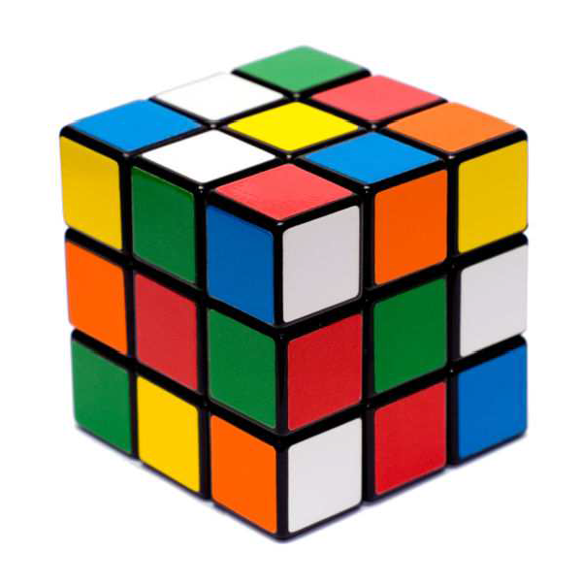
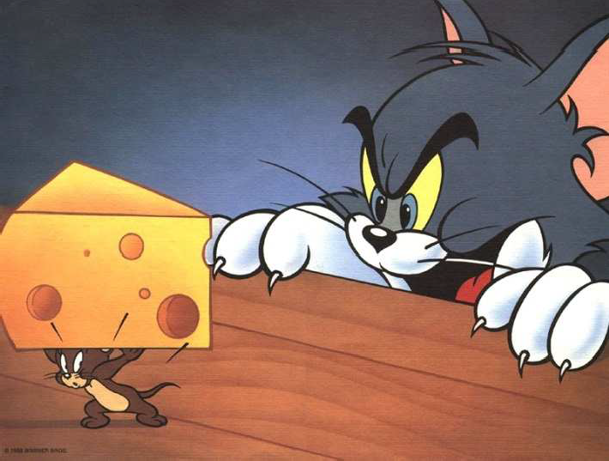
Static vs. dynamic
Is the world changing while the agent is thinking?
Static: Environment doesnʼt change unless agent performs an action. (e.g. crossword puzzles)
Dynamic: Environment changes even when the agent doesnʼt do anything. (e.g. traffic)
Semi-dynamic: The environment is static, but the agentʼs performance score changes over time. (e.g. chess against a clock)
vs.

Slide 29
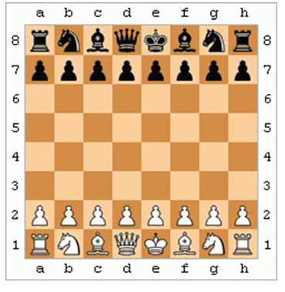
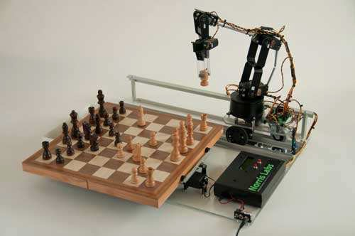
Discrete vs. continuous
Continuous: Time, percepts and actions are continuous.
Example: driving a car.
Discrete: Time, percepts and actions are discrete.
Example: playing a board game.
vs.

Slide 30
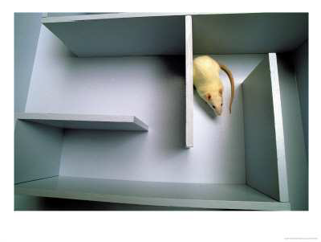
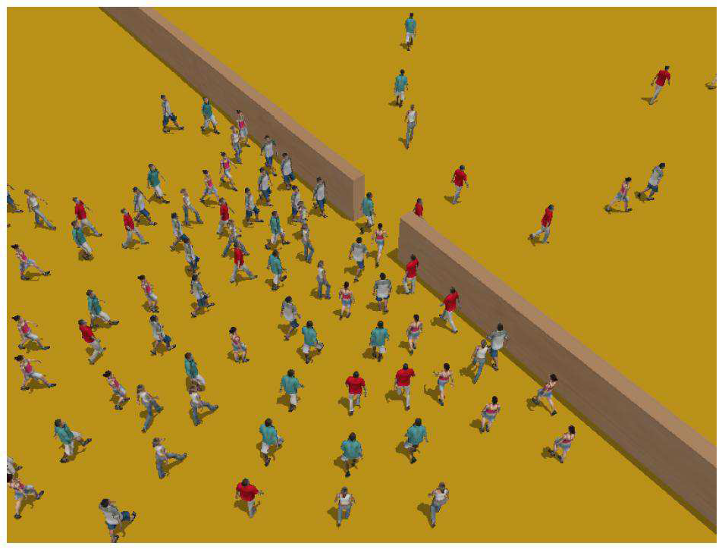
Single-agent vs. multiagent
Is an agent operating by itself in the environment?
vs.

Slide 31
Summary
Observable
Deterministic Episodic
Deterministic Sequential
Static
Discrete
Agents
Cross Word
Fully
Static
Discrete
Single
Poker
Fully
Stochastic
Sequential
Static
Discrete
Multi
Backgammon
Partially
Stochastic
Sequential
Static
Discrete
Multi
Taxi driver
Partially
Stochastic
Sequential
Dynamic
Conti
Multi
Part picking robot Partially
Stochastic
Episodic
Dynamic
Conti
Single
Image analysis
Fully
Deterministic
Episodic
Semi
Conti
Single

Slide 32
Agent Types
Four basic types in order of increasing generality:
Simple reflex agents
Reflex agents with state/model
Goal-based agents
Utility-based agents
Learning based Agents

Slide 33
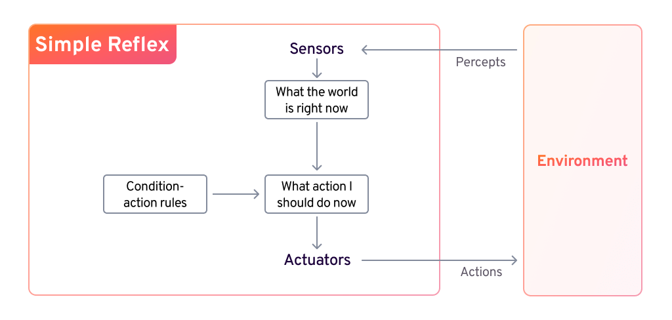
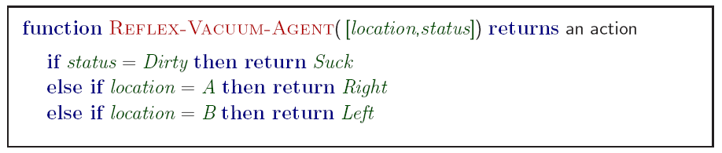
Simple Reflex Agents

Slide 34
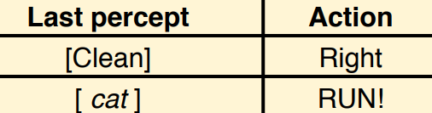
Simple Reflex Agents
Simple but very limited intelligence.
Action does not depend on percept history, only on current percept.
Therefore, no memory requirements.
hard to verify success for complex tasks
good for simple agents (bar code scanners, e.g.)

Slide 35
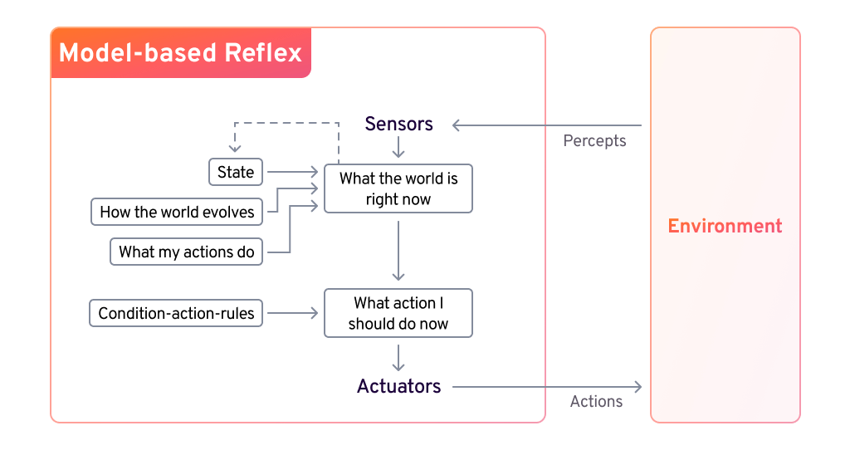
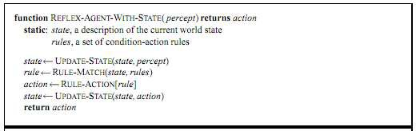
Model-based reflex agents
Know how world evolves
0 Overtaking car gets closer from behind
How agents actions affect the world
0 Wheel turned clockwise takes you right
• Model base agents update their state

Slide 36
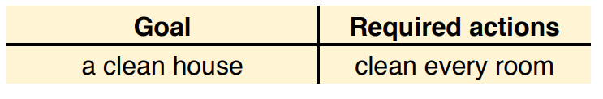
Goal-based agents
knowing state and environment? Enough?
Taxi can go left, right, straight
Have a goal
A destination to get to
Uses knowledge about a goal to guide its actions
E.g., Search, planning

Slide 37
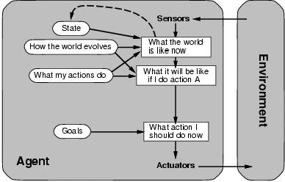
Goal-based agents
Reflex agent breaks when it sees brake lights. Goal based agent reasons
– Brake light -> car in front is stopping -> I should stop -> I should use brake

Slide 38
Utility-based agents
Goals are not always enough
Many action sequences get taxi to destination
Consider other things. How fast, how safe…..
Agent can choose between multiple actions to achieve its goal. Which is best?
Agent may have conflicting goals. Which one to pursue first?
Agents may have a utility function, which (ideally) approximates the external performance measure.
Economics: money.
Biology: number of offspring.
Your life?

Slide 39
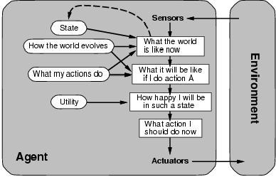
Utility-based agents

Slide 40
Learning agents(Taxi driver)
Performance element
How it currently drives
Taxi driver Makes quick left turn across 3 lanes
Critics observe shocking language by passenger and other drivers and informs bad action
Learning element tries to modify performance elements for future
Problem generator suggests experiment out something called Brakes on different Road conditions
Exploration vs. Exploitation
Learning experience can be costly in the short run
shocking language from other drivers
Less tip
Fewer passengers
40

Slide 41
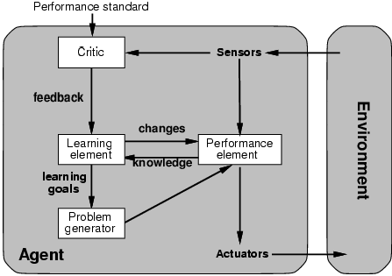
Learning agents
Performance element is what was previously the whole agent
Input sensor
Output action
Learning element
Modifies performance element.

Slide 42

Learning agents
Critic: how the agent is doing
Input: checkmate?
Fixed
Problem generator
Tries to solve the problem differently instead of optimizing.
Suggests exploring new actions -> new problems.

Slide 43
The End
41

